Slide 1

Seaborn Library
Keagan Schmidt and Ameera Syed

Slide 2
Library Applications
The Seaborn library is used for statistical graphs and is associated closely with Matplotlib. It integrates data structures from the Pandas and NumPy libraries. There are several plots that can be made using Seaborn, with some examples listed below:
Relational Plots | Shows relationship between two variables
Categorical Plots | Visualizes categorical data
Distribution Plots | Examines one or two distributions
Regression Plots | Visualizes data patterns
Matrix Plots | Array of scatterplots
Multi-plot Grids | Draw many instances of plots on different subsets of data

Slide 3
Installation
Seaborn comes preinstalled with Anaconda:
import seaborn
Install with pip:
pip install seaborn
Install with conda:
conda install seaborn
Dependencies: NumPy, Pandas, and Matplotlib
Optional (for additional features): Statsmodel, Scipy, Fastcluster

Slide 4
Key Commands
Common commands include:
...and many more!
load_dataset() | Loads built-in datasets, commonly used for demos and testing
histplot() | Plots histograms
kdeplot() | Plots a kernel density estimate
displot() | Plots various single variable distributions of data
scatterplot() | Creates scatterplots
relplot() | Creates relational plots
set_style() | Sets the aesthetic of the plots; examples include background, color, size, fonts, and grids

Slide 5
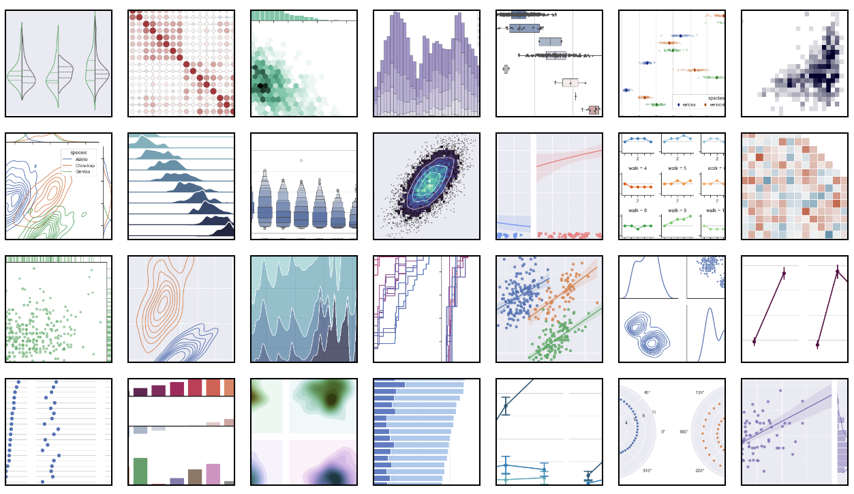
Library Showcase

Slide 6
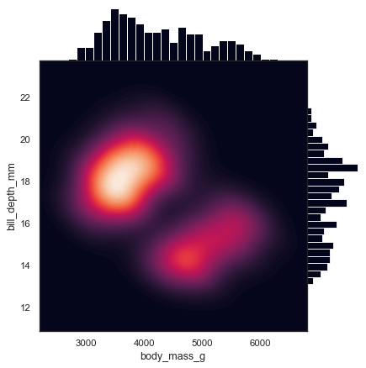
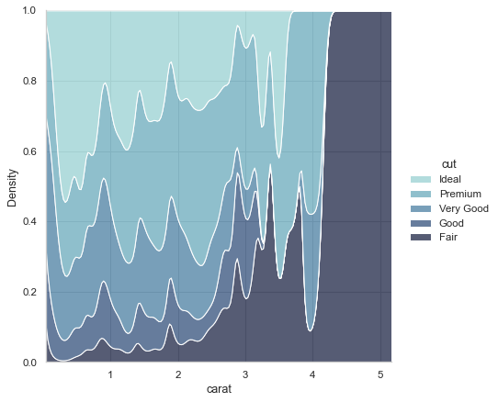
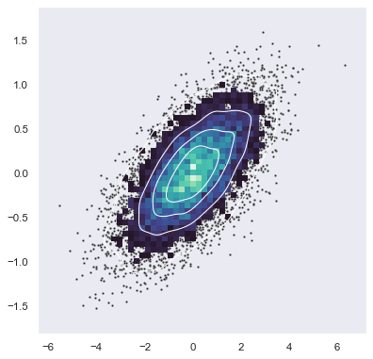
Library Showcase — Our Pick
Smooth kernel density with marginal histograms
Conditional kernel density estimate
Bivariate plot with multiple elements

Slide 7
Code Context and Origin
Our code represents how to create corresponding images using Seaborn. With Seaborn, scatterplots can be made, heat graphs, density graphs, and many more. The graphs we chose are only a select few of the possibilities Seaborn contains.
This library is tremendously useful for researchers and marketing specialists when data needs to be visualized in a beautiful, readable, and efficient way.
*The code was given in Seaborn’s documentation.

Slide 8
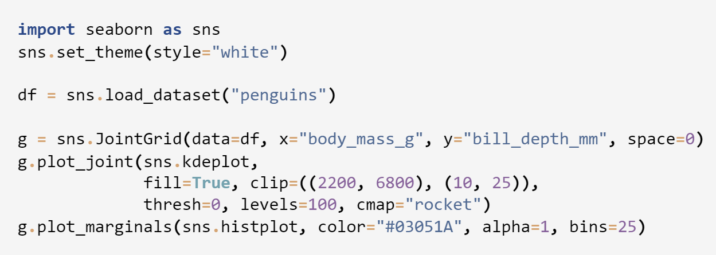
kdeplot()
Smooth kernel density with marginal histograms

Slide 9
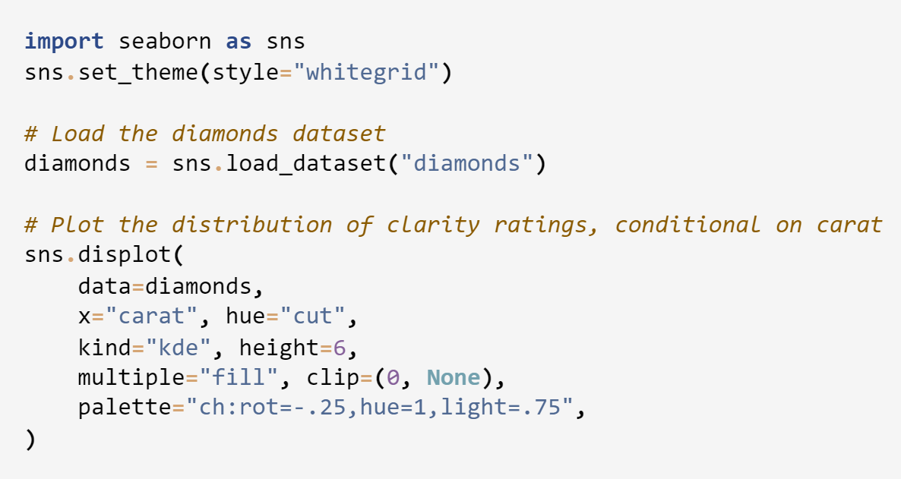
displot()
Conditional kernel density estimate

Slide 10
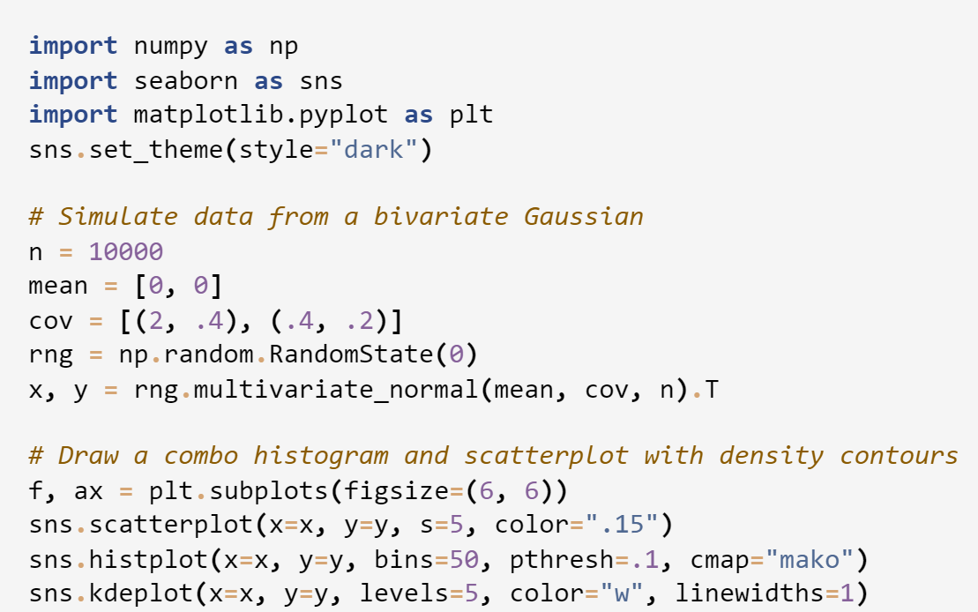
Multi-plot scatterplot(), histplot(), and kdeplot()
Bivariate plot with multiple elements

Slide 11
Code Specifics
Seaborn components used in previous code:
set_theme(), scatterplot(), histplot(), kdeplot(),load_dataset(), displot(), JointGrid()
Parameters and default values listed below:
seaborn.set_theme(context='notebook', style='darkgrid', palette='deep', font=‘sanserif’, font_scale=1, color_codes=True, rc=None)
seaborn.scatterplot(data=None, *, x=None, y=None, hue=None, size=None, style=None, palette=None, hue_order=None, hue_norm=None, sizes=None, size_order=None, size_norm=None, markers=True, style_order=None, legend='auto', ax=None, **kwargs)

Slide 12
Code Specifics – cont.
seaborn.histplot(data=None, *, x=None, y=None, hue=None, weights=None, stat='count', bins='auto', binwidth=None, binrange=None, discrete=None, cumulative=False, common_bins=True, common_norm=True, multiple='layer', element='bars', fill=True, shrink=1, kde=False, kde_kws=None, line_kws=None, thresh=0, pthresh=None, pmax=None, cbar=False, cbar_ax=None, cbar_kws=None, palette=None, hue_order=None, hue_norm=None, color=None, log_scale=None, legend=True, ax=None, **kwargs)
seaborn.kdeplot(data=None, *, x=None, y=None, hue=None, weights=None, palette=None, hue_order=None, hue_norm=None, color=None, fill=None, multiple='layer', common_norm=True, common_grid=False, cumulative=False, bw_method='scott', bw_adjust=1, warn_singular=True, log_scale=None, levels=10, thresh=0.05, gridsize=200, cut=3, clip=None, legend=True, cbar=False, cbar_ax=None, cbar_kws=None, ax=None, **kwargs)

Slide 13
Code Specifics – cont.
seaborn.load_dataset(name, cache=True, data_home=None, **kws)
seaborn.displot(data=None, *, x=None, y=None, hue=None, row=None, col=None, weights=None, kind='hist', rug=False, rug_kws=None, log_scale=None, legend=True, palette=None, hue_order=None, hue_norm=None, color=None, col_wrap=None, row_order=None, col_order=None, height=5, aspect=1, facet_kws=None, **kwargs)
class seaborn.JointGrid(data=None, *, x=None, y=None, hue=None, height=6, ratio=5, space=0.2, palette=None, hue_order=None, hue_norm=None, dropna=False, xlim=None, ylim=None, marginal_ticks=False)

Slide 14
Resources
[1] Seaborn
[2] GeekforGeeks

Slide 15
Thank you! Questions?
Notes:
Common error when running = UserWarning for tight_layout – Caused by Matplotlib error.

